Slide 1



Implications of Microgravity on Calcium Dynamics in the Cardiac Troponin Complex
Morgan Beckett
University of Arizona Department of Chemistry & Biochemistry
Mentor: Dr. Steven D. Schwartz
April 07, 2017

Slide 2
A Preview
Implications of Long-Term Microgravity Exposure on Astronaut’s Cardiac Health
Significance of Calcium Binding in Heart Muscle Contraction
Introduction to the Cardiac Thin Filament Model and Troponin Complex
Elucidating Calcium Dynamics in the Cardiac Troponin C Domain
Future Work

Slide 3

Microgravity & the Human Heart
Effects of long-term exposure to microgravity conditions on the human heart at the organ-level:
Deformation of the heart
Cardiac muscle atrophy
What are the effects of microgravity on the protein and molecular level?
NASA Astronaut Cady Coleman performs tasks in laboratory at the International Space Station as part of the Integrated Cardiovascular investigation – a study evaluating cardiac health in space, including the effect of long-duration spaceflight on heart shape and form.
Credit: NASA

Slide 4
Cardiac Muscle Contraction and Calcium Dynamics
Cross Bridge Cycle -- The mechanism of muscle contraction based on muscle proteins that slide past each other to generate movement.
Calcium binding in the pocket of cardiac troponin C acts as an initiating step in this contractility cycle.
The binding pocket is a site where dysfunctional calcium interactions can hold adverse implications for diseased cardiac states.
The biophysical mechanism by which calcium binds remains unclear.

Slide 5
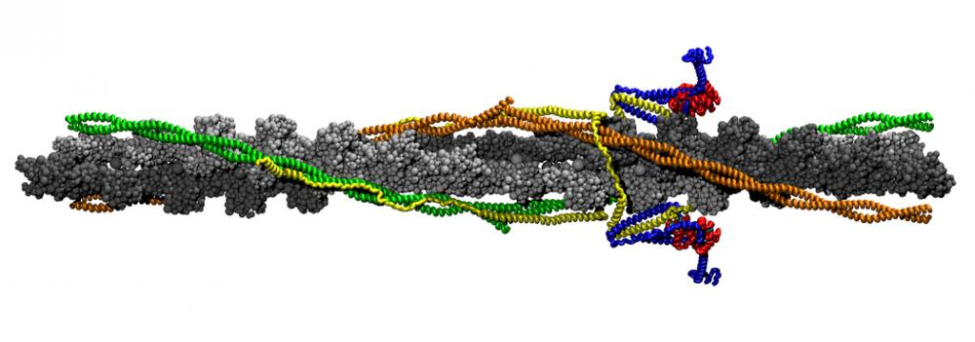
The Cardiac Thin Filament Model
Figure 1: Human cardiac thin filament (CTF) including cTn, Tm, and actin: yellow for cTnT, blue for cTnI, red for cTnC, cyan for calcium ion, green/orange for overlapping Tm, and silver/gray for actin filament.

Slide 6
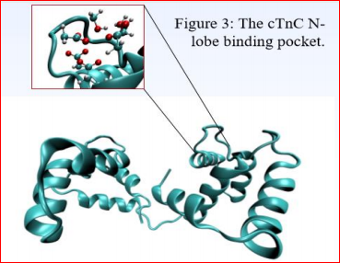
Calcium Binding Pocket of cTnC
Figure 2: Cardiac troponin C protein (cTnC)

Slide 7
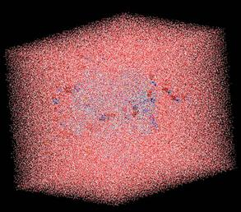
Experimental Set
Visual Molecular Dynamics
-The cTnC protein is solvated within a water box.
-Water box saturated with calcium ions.
Nanoscale Molecular Dynamics
- The solvated cTnC model was then allowed to reach an energy equilibrium prior to implementing molecular dynamics (MD) testing.
Figure 3: Protein model solvated in a water box.

Slide 8
Calcium Dynamics in the Cardiac Troponin C Domain
Steered molecular dynamics was applied to the cTnC model in order to find a potential transition path through directed molecular dynamics.
Energy calculations were performed to determine the proper force and velocity at which to forcefully remove the calcium from the binding pocket.

Slide 9
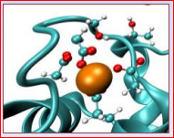
Calcium Dynamics in the Cardiac Troponin C Domain – Continued
The calcium ion was pulled at a velocity of 0.005 Å*fs-1 with a spring constant of 7.0 kcal/(mol*Å2 )
The vector path was calculated to be perpendicular to the center of two crossed lines made by connecting the Cα values of coordinating residues.
Figure 4: Three-dimensional axis superimposed upon cTnC binding pocket.

Slide 10
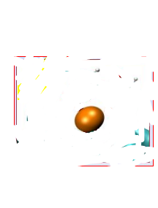
Calcium Dynamics in the Cardiac Troponin C Domain – Continued
Bound State
Dissociated State
Free Energy Path
From this constructed initial trajectory path, time splices are chosen at random along the free energy path length of the ion transitioning from the dissociated to the bound state.

Slide 11
Calcium Dynamics in the Cardiac Troponin C Domain – Results
The ion was unable to successfully bind within the cTnC binding pocket due to the unfavorable energetic nature of the ion to freely diffuse into the pocket,
The ion interactions with the oxygen sidechains outside of pocket being highly favorable – The energy barrier was too high for the ion to freely overcome on our short timescale.
Figure 5: cTnC unbound binding pocket

Slide 12
Future Work
Further additions of neighboring troponin protein subunits to the current model.
Eventual characterization of the ion binding and dissociation mechanism of calcium dynamics can be applied to synthesizing targeted drug therapies for returning astronauts.

Slide 13
Acknowledgments
Dr. Steven D. Schwartz
Michael Williams
Schwartz Group
Arizona Space Grant Consortium / NASA

Slide 14
Thank you

Slide 15
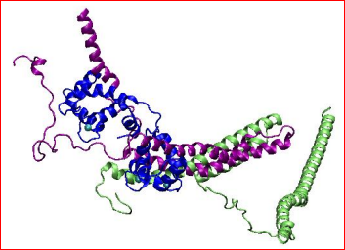
The Troponin Protein Complex
Figure 2: Cardiac troponin complex consisting of cTnI, cTnT, and cTnC: green for cTnT, purple for cTnI, and blue for cTnC.

Slide 16

Calcium Dynamics in the Cardiac Troponin C Domain – Energy Calculations
To calculate a potential of mean force at which to pull the ion, the work is calculated via the standard definition:
Eq 1:
where W is total work, k is the spring constant of the pseudospring, v is the velocity at which the pseudoatom is pulled, t is time, and F is the force that the spring feels.

Slide 17


Calcium Dynamics in the Cardiac Troponin C Domain – Energy Calculations
The ensemble average is calculated using the second cumulant expansion:
Eq 2:
where β is the inverse of the multiplication of the Boltzmann constant and temperature. Jarzynski’s equality can be used to equate the ensemble average of the calculated work to the free energy of Ca2+ release:
Eq 3:

